Slide 1
New CIS Developer Workshop
New CIS Programme 18th July 2006

Slide 2
Agenda
Introductions (5 mins) 11:00
Updates on CIS Reform -- Paul Martin (20 min) 11:05
CIS from a Developers Perspective – Dennis Keeling (20 min) 11:25
CIS Data Quality Standard -- Paul Martin (30 min) 11:45
Break for lunch 12:15
Support for Agents -- Jo Bell (30 min) 12:45
Comms Strategy – Jo Bell (15 min) 13:15
Questions 13:30

Slide 3
New CIS Developer Workshop
Introduction – Paul Martin

Slide 4
New CIS Developer Workshop
Update on CIS Reform – Paul Martin

Slide 5
Changes to Tech Pack
Some minor upcoming changes to tech pack
  Schema Changes
    Works Reference Number added to Monthly Return
    Added after requests from some vendors -> field is not stored or used by HMRC
    Accounts Office Reference format changed to support Centre 1 Cases
      Characters 6-13 now alphanumeric (previously numeric)
      Centre 1 Cases (Scotland) may have an ‘X’ as the last character
  Non-schema changes
    Name handling: it will be acceptable to submit personal names (e.g. John Smith) as trading names
    Unincorporated Bodies - for online verifications these should now simply be treated as companies without CRNs (i.e. set business type to ‘company’)
Changes will be rolled out to TPVS in the next release – 1st November 2006

Slide 6
Supporting Documentation
HMRC will be releasing some new documents over the next few weeks (by end July) to give further support to vendors and their customers
  Combined Quality Standard/Business Validation Rules (QS/BVR)
  Software Developer FAQs
    Covers common questions and misunderstandings
    Important that all developers look at these
  Online FAQs
    Currently there is limited information on the HMRC website about the upcoming online service
    these FAQs will plug this gap and will be available from the New CIS pages (http://www.hmrc.gov.uk/new-cis/index.htm)
  CIS333 Technical Specification (Subcontractor List)
  http://www.hmrc.gov.uk/ebu/cis-online.htm- List of vendors that have achieved internet recognition

Slide 7
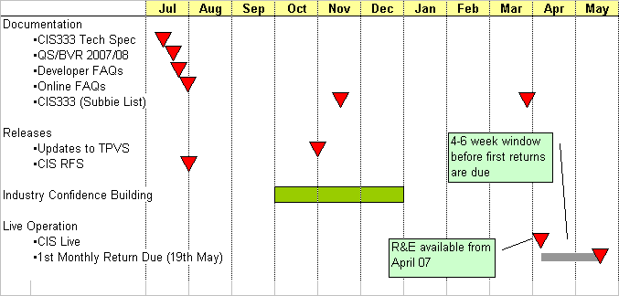
Timeline

Slide 8
New CIS Developer Workshop
CIS Data Quality Standard – Paul Martin

Slide 9
CIS Quality Standard/Business Validation Rules
A CIS Data Quality Standard has been produced (cf PAYE)
Following departmental strategy this is being combined with (and will replace) the existing business validation rules
The combined CIS QS/BVR will
  Document the business validation rules
  Provide additional information to help developers to understand minimum data standards (over and above the schema rules)
  Highlights common errors based on experience with other service lines (esp. PAYE)
  Is an important aid to getting your customer’s data right and avoiding filing problems
QS/BVR will be published by end July

Slide 10
CIS QS/BVR – Key Learning Points
Some common themes have emerged
  In developer queries
  Based on filing performance in other service lines
  Misunderstandings within our own IT supplier
Following slides highlight key misunderstandings and problem areas

Slide 11
CIS QS/BVR – Name Formats
Personal Names
  Forename fields do not support spaces
    If the subcontractor has two forenames do not enter both in the first forename field, e.g. Anne Marie
    You can enter as Anne-Marie or Anne in this field and Marie in the second name field
  Do not use ` instead of ‘
  Remove trailing spaces
  Do not enter asterisk (*) or use ‘0’ (zero) instead of ‘O’
Trading Name fields are more relaxed about character sets
In general, we expect fewer occurrences of name problems compared to the PAYE service, but note that CIS has no tolerances – so name data must be clean.

Slide 12
CIS QS/BVR – Name Formats
Trading Name field should be used to supply any names that are not personal names
  Individual trading names (where they exist)
  Company Registered Name OR a Trading Name
  Partner Registered Name OR a Trading Name
    When verifying a partnership you must supply both the partnership details and the partner being engaged
  Trust Registered Name OR a Trading Name
If there is any doubt about name type use the Trading Name field

Slide 13
CIS QS/BVR – Monthly Return Optional Fields
The following fields are optional (because in some circumstances the data may not be available) but should be provided where available
Subcontractor identity data
  Individual: UTR + Name + NINO
  Company: UTR + Name + CRN
  Trust: UTR + Name
  Partnership: Partnership UTR + Partnership Name
For Gross and Standard Rate of Deduction cases -> UTR and Name are mandatory
  NINO and CRN are completely optional (whether they exist or not)
  However, supplying NINO and CRN will increase the change of HMRC matching the subcontractor details
For Higher Rate of Deduction cases -> just Name is mandatory
If data is not available omit the element, do not send an empty element

Slide 14
Aside: HMRC Subcontractor Matching on receipt of a monthly return
To achieve a full match on a subcontractor HMRC must match on all data items provided, e.g.
  UTR + Name
  UTR + Name + NINO
If a full match cannot be made then a partial match is attempted
  UTR and NINO (or CRN)
  UTR and Name
  Name and Verification Number (where verification number is unique)
  NINO and Verification Number (where verification number is unique)
  Name and NINO (or CRN)
  UTR (verified against this scheme)
Partial matches will result in a compliance risk being raised. If there are significant compliance risks this may result in a follow-up investigation.

Slide 15
CIS QS/BVR – Verification Optional Fields
 | Action | Subcontractor UTR | NINO | CRN | Subcontractor Name (Personal Name or Trading Name)
Sole Trader | Verify | O | O | N/A | M
 | Match | M | O* | N/A | M
Company | Verify | O | N/A | O | M
 | Match | M | N/A | O* | M
Trust | Verify | O | N/A | N/A | M
 | Match | M | N/A | N/A | M
Notes
Although NINO or CRN are always optional – the submission will not be rejected – if a registered subcontractor has a NINO or CRN they must be provided in order for us to provide a match
If there is no available NINO or CRN then the element should be omitted

Slide 16
CIS QS/BVR – Partnership Verification Optional Fields
 | Action | Partner |  |  |  | Partnership
 |  | UTR | NINO | CRN | Name | UTR | Name
Sole Trader | Verify | O | O | O | M | O | M
 | Match | C | C | N/A | M | M | M
Company | Verify | O | O | O | M | O | M
 | Match | C | N/A | C | M | M | M
Trust | Verify | O | O | O | M | O | M
 | Match | M | N/A | N/A | M | M | M
Notes
For the partner details you only need to provide one of Partner UTR or NINO or CRN in addition to the Partner Name (Personal or Trading Name)

Slide 17
CIS QS/BVR – Monetary Fields
Monetary fields must always be to 2 decimal places. If the field only allows ‘whole pounds’ – I.e. Total Payments Made or Direct Cost of Materials - the user interface may only allow entry in whole pounds or the user may enter the amount excluding the pence (e.g 100). However, the xml will show this as 100.00. The schema enforces the .00.
Note that leading zeros are not allowed for amounts above 0.99. Also do not use commas in place of a decimal point.
When calculating a whole pound monetary field any pence in the original payment should simply be truncated (e.g. a Total Payment of £535.75 should be reported as £535.00). No rounding of pence is required.

Slide 18
CIS QS/BVR – Authenticating the Submission
Frequently authentication errors occur by using the Employer’s PAYE Reference – the EMPREF – incorrectly. Contractors or their agents will get an error saying “Authentication failure. The supplied user credentials failed validation for the requested service” where they:
  use an incorrect user ID
  use an incorrect password
  use a password of more than 12 characters
  have not registered to use CIS Online
  have not activated CIS Online
  enter the PAYE reference in lower case
  (agent only) the client is not shown on the agents client list

Slide 19
CIS QS/BVR – Authenticating the Submission
A valid PAYE reference consists of the Tax Office Number and Tax Office Reference.
They are unique only in combination, for example 913/WZ51258. Errors will occur where the contractor showed the contractor’s HMRC office PAYE reference only (WZ51258) or used the tax office number (tax district reference) twice (913/913WZ51258).
Note that the PAYE reference must be supplied in the GovTalk Header and IRHeader envelopers in the Keys field
The UTR and AO reference must be supplied as part of the business data defined in the verification request and monthly return schemas
It is the PAYE reference that should be quoted on statements of deductions – NOT the UTR as was shown on some earlier presentations

Slide 20
CIS QS/BVR – Duplicates
Only one monthly return can be sent each month per scheme
Verification Requests should not contain duplicate subcontractors. A duplicate subcontractor is a subcontractor where
  The UTR and NINO/CRN is the same AND the subcontractor matches to a registered subcontractor
For unmatched subcontractors (usually where there is no UTR) then you may have multiple entries with identical details – but these are not duplicates
  For example a verification request with two John Does

Slide 21
CIS QS/BVR - Polling
Avoid continual polling
  Continual polling can be a source of irritation for users as it can prevent them moving on to other transactions (e.g. performing another verification or filing another monthly return).
  This can be a particular frustration for agents/bureaux who may wish to file multiple returns or perform multiple verifications.
It is recommended that developers adopt a similar approach as used for PAYE, i.e. polling approx. each 10 secs for an initial period of 30-40 secs.
  If no response has been received by that point the system should reduce the polling frequency
  Further polling may be user driven (e.g. when the user next logs on to to the application) or asynchronous (in this case the interval between successive polls may increase).
  Overnight polling will help spread loads.

Slide 22
Other Points – Multiple Payments
Multiple payments to the same subcontractor
  The preferred HMRC solution is for all payments to a registered subcontractor to be reported as a single payment entry on the CIS300 for the given UTR.
  If New CIS receives multiple payment records for a given UTR (i.e. from an HMRC viewpoint a single subcontractor appears more than once on a return) then a compliance risk will be recorded and noted for possible future action. This is to allow New CIS to identify cases where the same subcontractor identity may be being used fraudulently.
  HMRC does not expect – under any circumstances - payments made to the same account within a given monthly period to be reported separately (e.g. weekly payments, adjustments)

Slide 23
Other Points - CIS333 Subcontractor List
In Nov HMRC is sending every contractor a list of subcontractor’s they’ve paid since April 2005 where we can see they have shown the contractor a Registration card or Certificate that is valid beyond 5 April 2007.
A further list will be sent before April 2007 – which will supersede the previous list
Information on the list will be based on vouchers submitted to HMRC – so it is vital that contractor’s get their vouchers in on time
Subcontractor’s appearing on the list don’t need to be verified in New CIS, provided you pay them by 5th April 2009
If the list contains less than 125 subcontractors it will be sent on paper (with a letter explaining how to use it)
If the list contains 125 contractors or more it will be sent on a CD-ROM (again with a covering letter)
  The data on the CD-ROM will be in comma separated values format (.csv)

Slide 24
CIS333 Subcontractor List cont…
The list will show the subcontractor name, their unique tax reference, their NINO or CRN, the date of the last voucher payment and the tax treatment you should apply
CSV format
  Contractor Name,Contractor UTR,Scheme ID
  XXXXXXXXXXXXXXXXXXXXXXXXXXXX,9999999999,001
  Subcontractor's UTR,Subcontractor's Name,National Insurance number or Company registration number,Tax month last paid,Tax treatment
  9999999999,XXXXXXXXXXXXXXXXXXXXXXXXXXXX,XX999999X,DD/MM/YYYY,GROSS
  9999999999,XXXXXXXXXXXXXXXXXXXXXXXXXXXX,99999999,DD/MM/YYYY,NET
  9999999999,XXXXXXXXXXXXXXXXXXXXXXXXXXXX,XX999999,DD/MM/YYYY,GROSS
Primary purpose of the CIS333 is to help reassure contractors about who they do and do not need to verify
  May also be of use to check that contractor data is up-to-date and has been

Slide 25
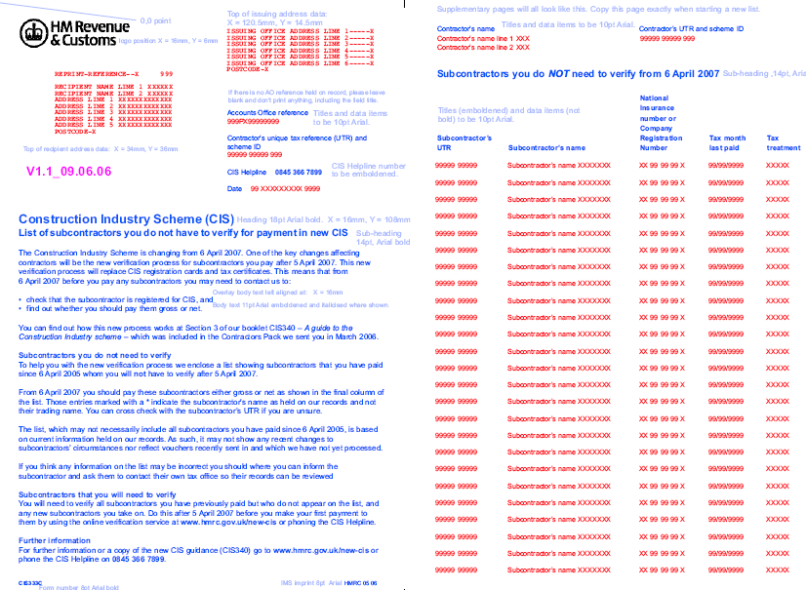
Draft Only

Slide 26
CIS333 – Subcontractor List cont..
Some words of caution
  Don’t use the list to simply update (overwrite) existing data,
  Only the first 28 characters of the subcontractor name provided
  In most cases (80%) the trading name is provided
  Some names will be preceded by a *
    indicate a subcontractor’s name as held on our records and not their trading name
    you should cross check with the subcontractor’s UTR if you are unsure
  In some exceptional cases no NINO will be present (only verified NINOs are listed)
If in doubt about data the contractor will need to double-check with the subcontractor
Note that paper list will be in UTR order

Slide 27
New CIS Developer Workshop
CIS from a Developer’s Perspective – Dennis Keeling (BASDA)

Slide 28
New CIS Developer Workshop
Support for Agents – Jo Bell

Slide 29
CIS Agents - General Rules
An Agent authorised to act on behalf of a Customer in SA or CT will also be authorised to conduct CIS business, unless the customer specifically states that they do not wish the agent to act on their behalf for CIS
When a Scheme is registered in CIS, the owning contractor’s existing SA or CT agent will by default be authorised to represent the CIS customer and their scheme, unless the contractor specifies otherwise or there is a CIS scheme specific agent
A Contractor’s existing SA or CT Agent will not automatically receive scheme output for the scheme, the Agent or Contractor must contact HMRC to request this
A Contractor can specify a scheme specific CIS agent that is different to their customer level SA or CT agent
A Scheme specific agent is only authorised to transact on behalf of the specified scheme within CIS Reform

Slide 30
Current paper 64-8
(inc. CIS scheme-only request)
64-8
HMRC receive
64-8
Work-item created to process
HMRC updates HOD’s (e.g SA),
Request CIS
scheme-only
agent?
N
HMRCdo nothing on CIS Core.
CIS Core will automatically pick up changes through Inherit Flag
Y
HMRC access Update Registration on CIS Core
Search for scheme
Scheme
Agent(s)
exist?
Y
Scheme Agent(s) removed.
Un-set Agent Indicator
N
Output
authorised?
Y
Output Flag set
N
New Agent can act on behalf but not receive output
Systems updated

Slide 31
CIS Agents – Internet rules
To transact with HMRC on behalf of CIS schemes Internet agents must be enrolled for the PAYE/CIS agent service
Existing PAYE agents will acquire the CIS service by default
Existing SA or CT agents or new agents should use OPRA to obtain a HMRC PAYE/CIS Agent reference
Once Agent reference obtained then use Online Agent Authorisation Tool (OAAT) to receive full authority to act on behalf of the client
Agents without authority will be allowed to submit monthly returns on behalf of a client

Slide 32
Online Agent Auth. Tool (scheme level)
Agent
Online Auth. Tool
Agent Allocation msg. created
Agent Allocation msg. received by CIS Core
Existing
Scheme
Agent?
Y
Scheme Agent overwritten
Date of change recorded
N
Address held?
Y
Add Address pointer
Set CIS Scheme flag and Output Indicator on CIS Core
N
Set CIS Scheme Agent flag on CIS Core

Slide 33
New CIS Developer Workshop
Comms Strategy – Jo Bell

Slide 34
HMRC Comms – Q1/Q2 2006
HMRC have issued a number of communication products to customers in Q1/Q2 this year to ensure they are aware of the changes and are making plans to get ready
It is useful for developers to be aware of planned communications to since
  they are useful products in their own right
  this may drive up calls to vendors from concerned/interested customers
Products issued so far
  Contractors Pack (consisting of CIS340 and fact sheets) – Jan ’06
  Agents Pack – collection of key fact sheets
  Subcontractor Mailing - Information about the new scheme
  July Quarterly Bulletin – focusing on verifications

Slide 35
HMRC Comms – Q3/Q4 2006
More mailings are planned for the second half of this year
  Further ‘Quarterly’ Bulletins – Sep, Dec and Mar
    December mailing will focus on online filing (although online is also covered in all other mailings)
  CIS333 Subcontractor List – Nov 06/Mar 07
  New CIS Update - A publication for contractors - Sep 06
Further BST workshops
HMRC will be providing support at some industry conferences/roadshows
  If you are interested in HMRC supporting any customer conferences etc then you can request support by contacting Michele.stevens@hmrc.gsi.gov.uk
  No guarantees – we already have 300+ invites and resources are limited – but we are keen to provide support where we can

